Slide 1

RaspberryPi
05/02/2021 - Hardware ZeProgFactory/RaspberryPi: RaspberryPi goes .Net (github.com)

Slide 2
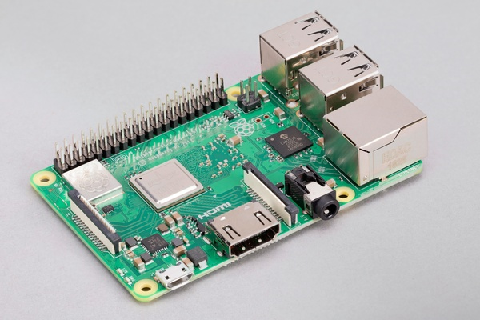
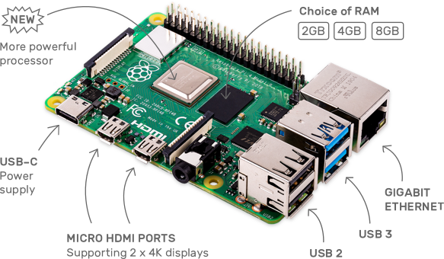
Pies
Raspberry Pi 3 Model B+ Raspberry Pi 3 Model B+ – Raspberry Pi
Raspberry Pi 4 MODEL B Raspberry Pi 4 Model B – Raspberry Pi
Notes:
Raspberry Pi 3 Model B+
Very low consumption
Touch screen case
Raspberry Pi 3 Model B+ | Raspberry Pi 3 B+, 1 Go | RS Components (rs-online.com) ~31 € HT
Raspberry Pi 3 Modèle B+ 1 GB – KUBII ~36 € HT
Raspberry Pi 4 Model B
Most recent & powerfull model
Boot on USB stick → easy maintenance
Raspberry Pi 4 Modèle B - 2GB – KUBII ~34 € HT
Raspberry Pi 4 Modèle B - 4GB – KUBII ~51 € HT
Raspberry Pi 4 4G Model B | Raspberry Pi 4 B 4 Go, 4 Go | RS Components (rs-online.com) ~50 € HT
!!! Always: Raspberry Pi + Case + µSD + Power supply
µSD >= 8 GB
Power supply RSB3 µUSB ~ 2.5 A (with touch screen)
Power supply RSB4 USB-C ~ 3.0 A (with touch screen)

Slide 3
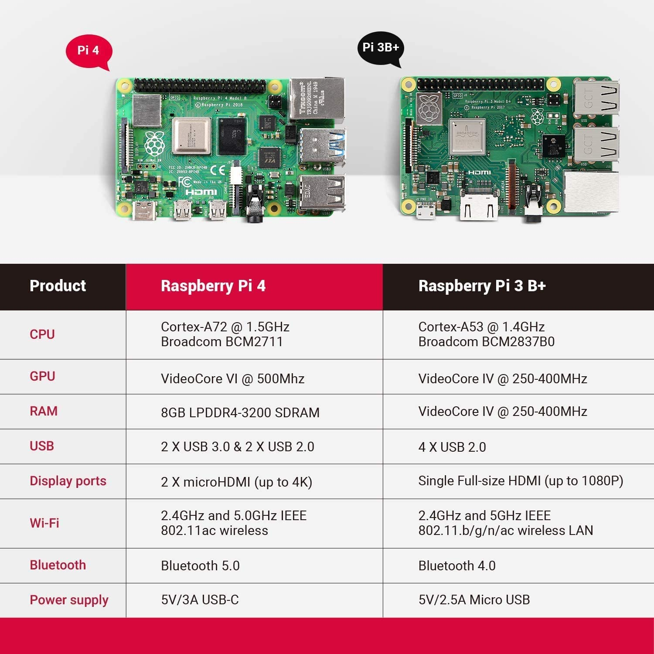
Pies
2,4,8
Notes:
RBP3 1 GB RAM
RBP4 2,4,8 GB RAM

Slide 4
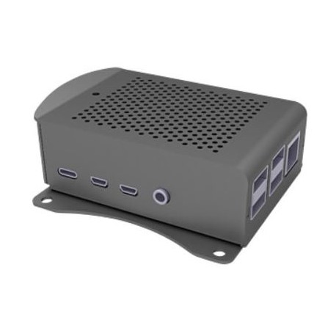
RBP4 - Case w/wo external screen
Boîtier aluminium avec support, pour Raspberry Pi4 – KUBII
~ 13 € HT

Slide 5
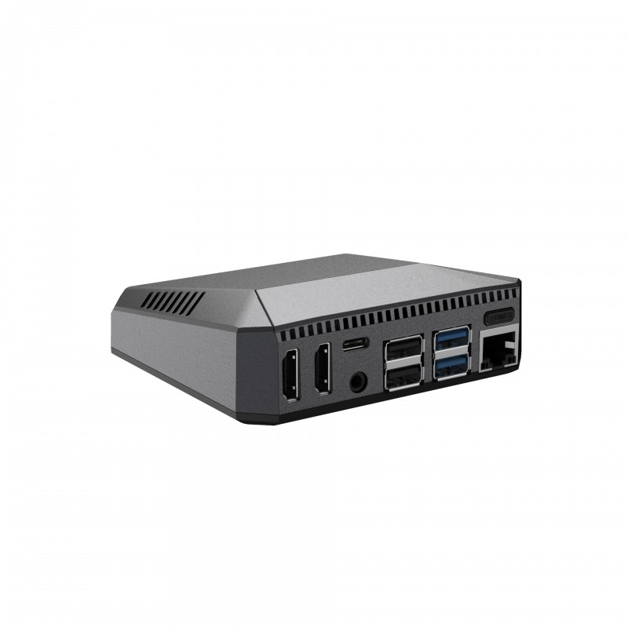
RBP4 - Case w/wo external screen
Boîtier ventilé pour Raspberry Pi 4 bouton ON/OFF – KUBII
~ 24 € HT
Notes:
Ventilated housing
ON/OFF button

Slide 6
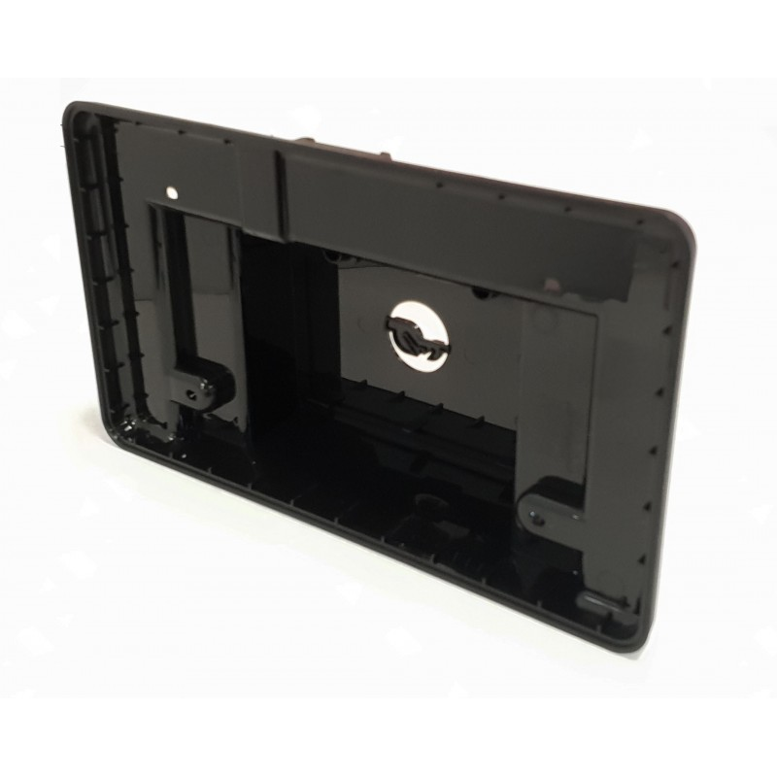
RBP4 - Case for 7” touchscreen
Support d'ecran officiel Raspberry PI – KUBII
~ 14 € HT
Notes:
? Ventilation

Slide 7
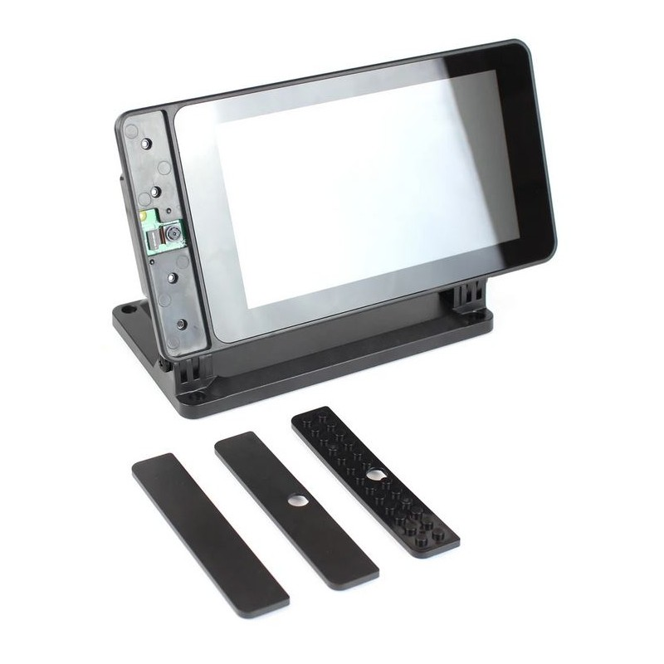
RBP3/4 - Case for 7” touchscreen
Support SmartiPi Touch – KUBII
~ 25 € HT
Notes:
RSB3 & RSB4
Camera option on font
Multiple support

Slide 8
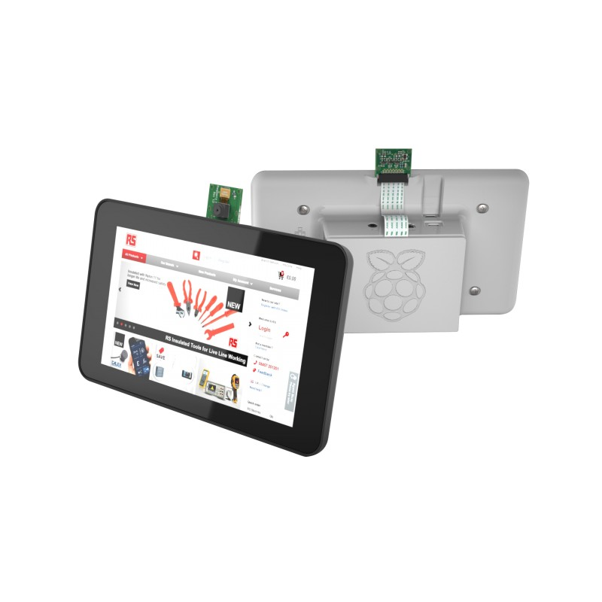
RBP3 - Case for 7” touchscreen
Support d'ecran officiel Raspberry PI - KUBII
~ 17 € HT
ASM-1900035-21 | Boîtier DesignSpark en ABS Noir | RS Components (rs-online.com)
~ 17 € HT
Notes:
RSB3 only

Slide 9
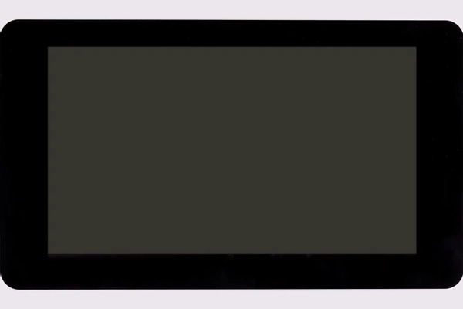
Raspberry Pi 7” Touch Display
Ecran Tactile Officiel 7" 800x480 – KUBII
~59 € HT
Raspberry Pi Touchscreen | Ecran Raspberry Pi 7pouces avec Ecran tactile capacitif | RS Components (rs-online.com)
~ 54 € HT
Notes:
800 x 480 display
10-finger touch

Slide 10
Recap
# | RSB | Case | Screen | Power | µSD / USB | Total
1) RSB3B+ | 31-36 € |  | X | 8 € | 10 €
2) RSB3B+ | 31-36 € | 17-25 € | 54-59 € | 8 € | 10 € | 121..146 €
3) RSB4B | 34 € | 13 € | X | 9 € | 10 € | 66 €
4) RSB4B | 34 € | 14-25 € | 54 € | 9 € | 10 € | 121..132 €
1) and 3) for external screen (customer feedback)
2) and 4) internal 7” screen (controller & agent)

